Slide 1
GAAR and Multilateral Instrument for preventing the base erosion and profit shifting – Indian scenario
Pramod Kumar
Sr Member, Income Tax Appellate Tribunal-India
SEMINARIO DI AGGIORNAMENTO PROFESSIONALE
PER I MAGISTRATI TRIBUTARI, ROME * SEPTEMBER 29,2017
Pramod Kum

Slide 2
Some significant steps taken in India to prevent Base Erosion and Profit Shifting
Implementation of General Anti Avoidance Rules, after a long consultative process with the stakeholders, with effect from i.e. 1st April 2017
Signing of Multilateral Instrument (MLI), taking a clear stand on the provisions of the MLI and notifying 93 Indian tax treaties as CTA (Covered Tax Agreements)
Introducing POEM (Place of Effective Management) Guidelines for deciding fiscal domicile of an entity, with effect from 1st April 2016
Strengthening effective exchange of information under tax treaties, renegotiating related treaty provisions, where required, to make them compatible with the best practices globally for ensuring highest transparency and furthering global efforts to combat tax evasion/black money,

Slide 3
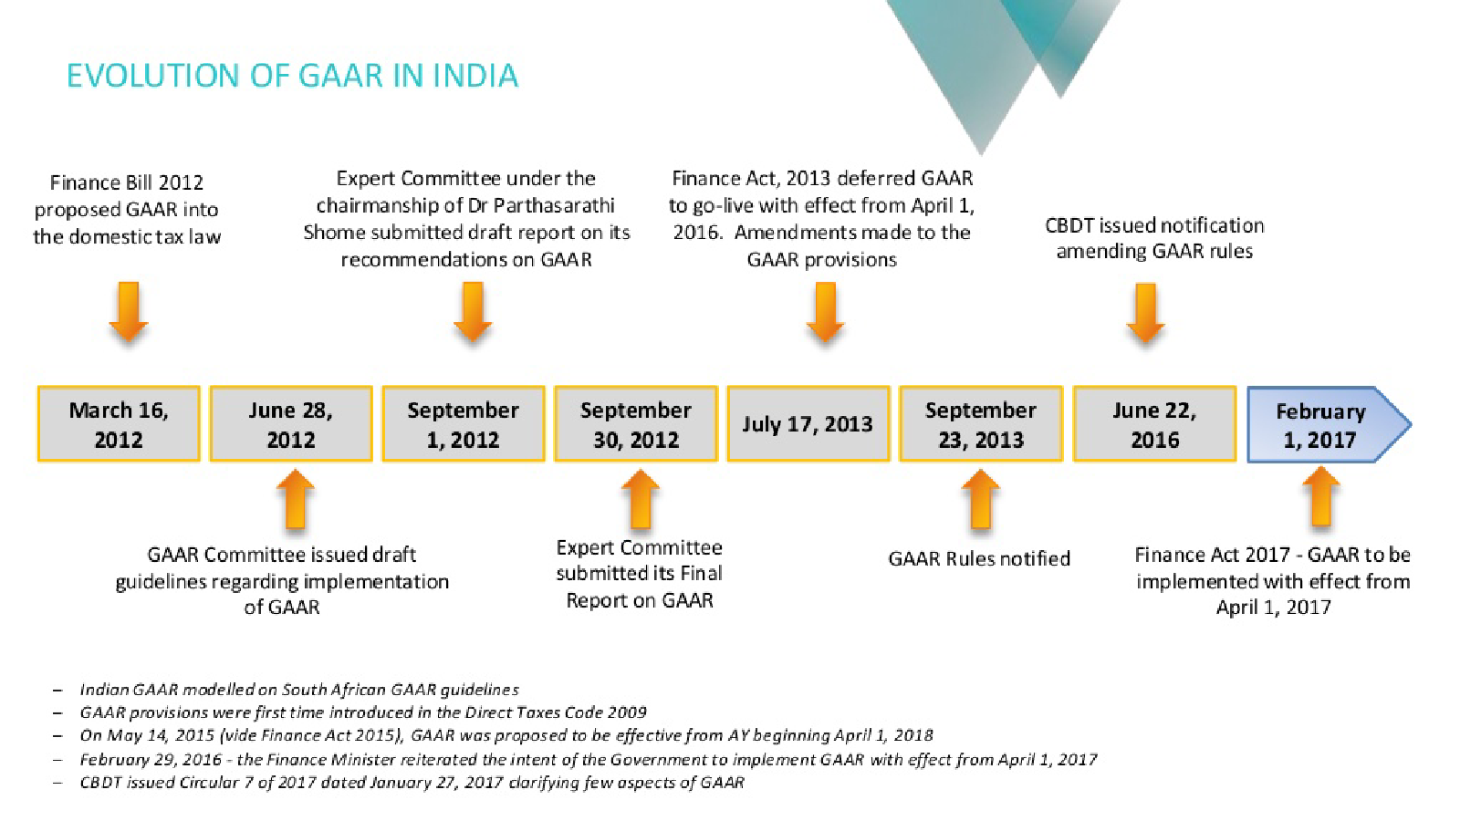

Slide 4
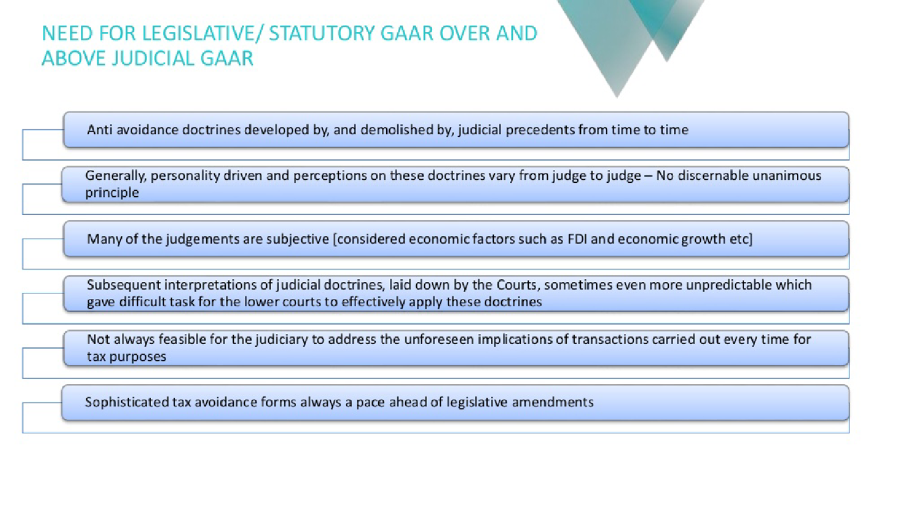

Slide 5
Was GAAR necessary because of inconsistent judicial approach on substance vs form principle
Is the legislation on GAAR intended to fill in this gap created by, what tax administration may perceive as, judicial inertia and inconsistency in applying judicial doctrine of substance over form.
Doctrine of substance over form, a judicial creation, is invoked which taxpayer has conducted a scheme of transactional relationships in documents and has a view on tax advantages that flow from tax reporting based on such transactional relationships, rather than on the substance of arrangement. The economic reality is thus hidden and transaction exists in form

Slide 6
Dilution of the substance over form principle
It is a controversial issue as to whether doctrine of substance over form can be invoked only when the form of transaction is completely tax driven or whether it can also be invoked when tax motivation clearly outweighs the business purpose or profit objective.
Judicial precedents earlier in this decade, notably in the case of Vodafone International Holdings BV involving $ 2.5 billion tax dispute, seem to be in favour of the former approach as on now, though many believe that there is little conceptual justification in its support
The courts sometimes take a legalistic stance and blame insufficient legislation creating opportunities for tax evasion

Slide 7
Indian Supreme Court’s observations in Vodafone case
……GAAR intends to prevent tax avoidance, what is inequitable and undesirable.……Necessity to take effective legislative measures has been felt in this country, but we always lag behind because our priorities are different. Lack of proper regulatory laws, leads to uncertainty and passing inconsistent orders by Courts, Tribunals and other forums, putting Revenue and tax payers at bay
It is often said that insufficient legislation in the countries…… gives opportunities for money laundering, tax evasion etc. and, hence, it is imperative that that Indian Parliament would address all these issues with utmost urgency.

Slide 9
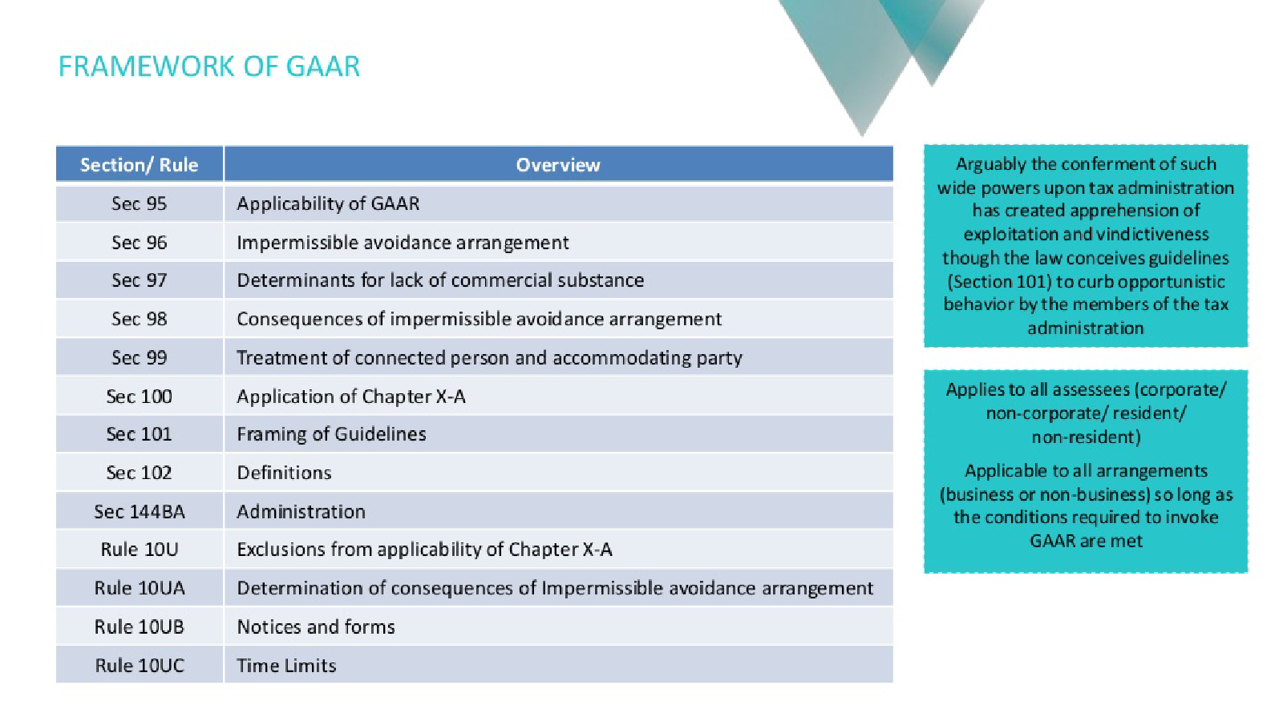

Slide 10
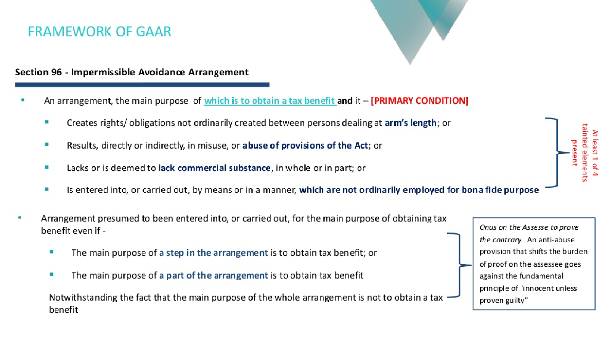

Slide 11
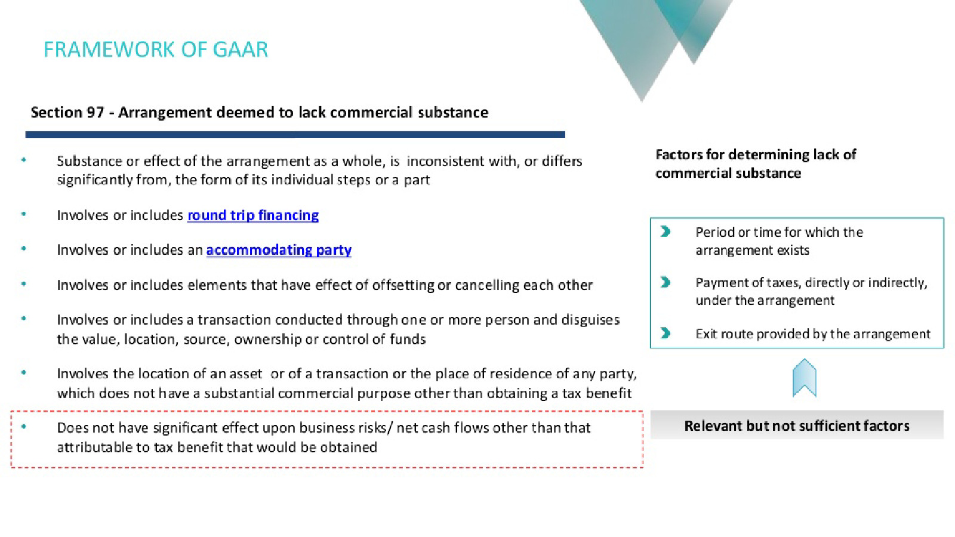

Slide 12
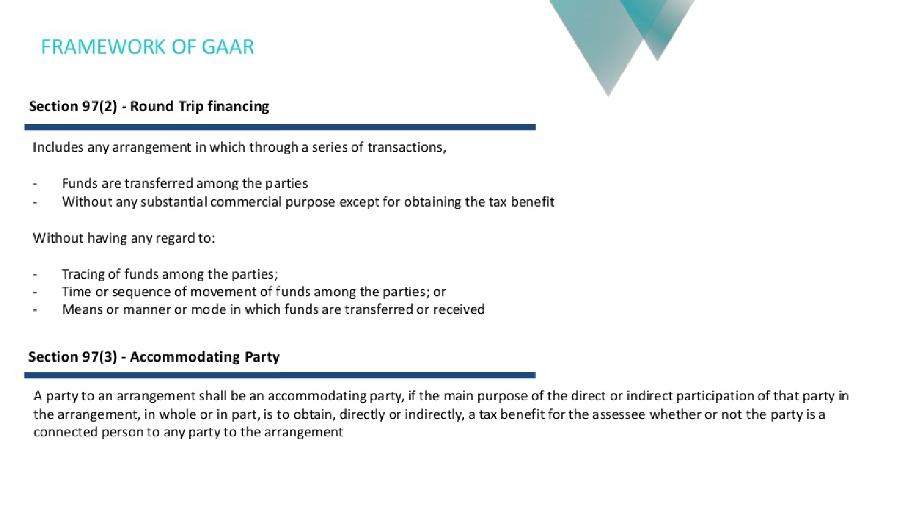

Slide 13
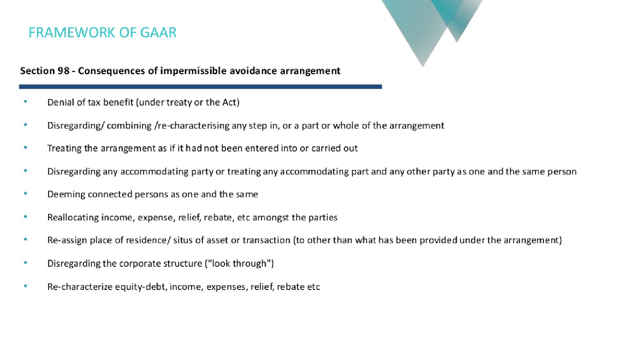

Slide 14
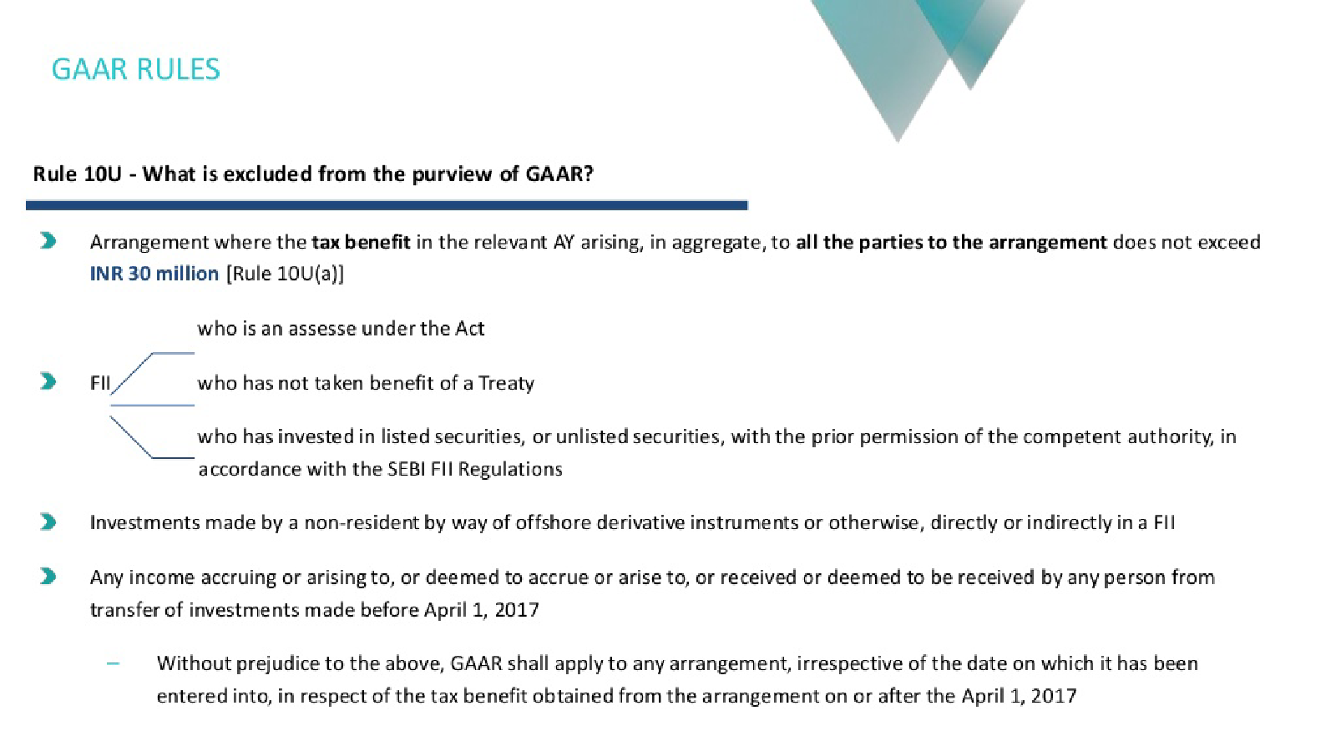

Slide 15
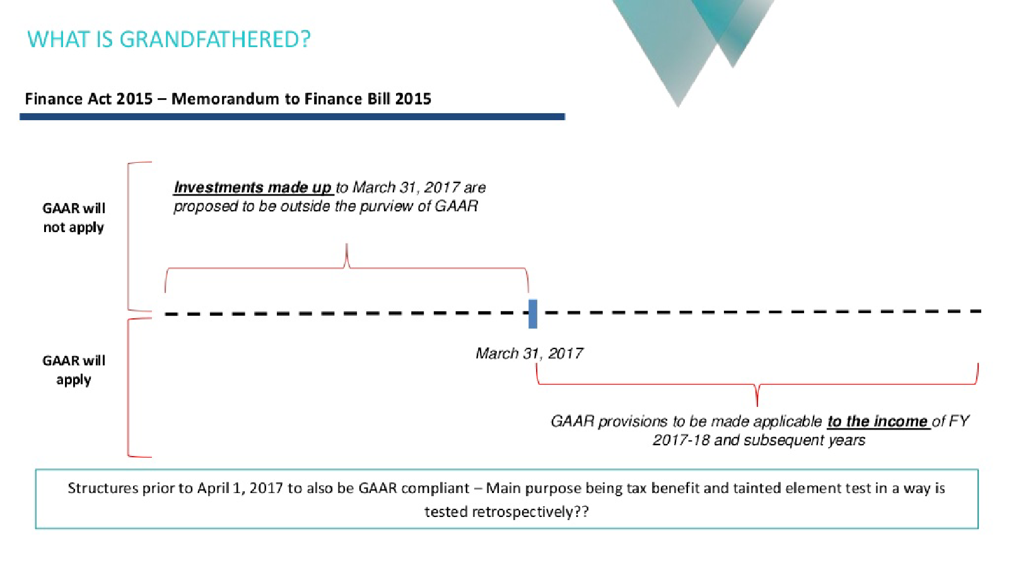

Slide 16
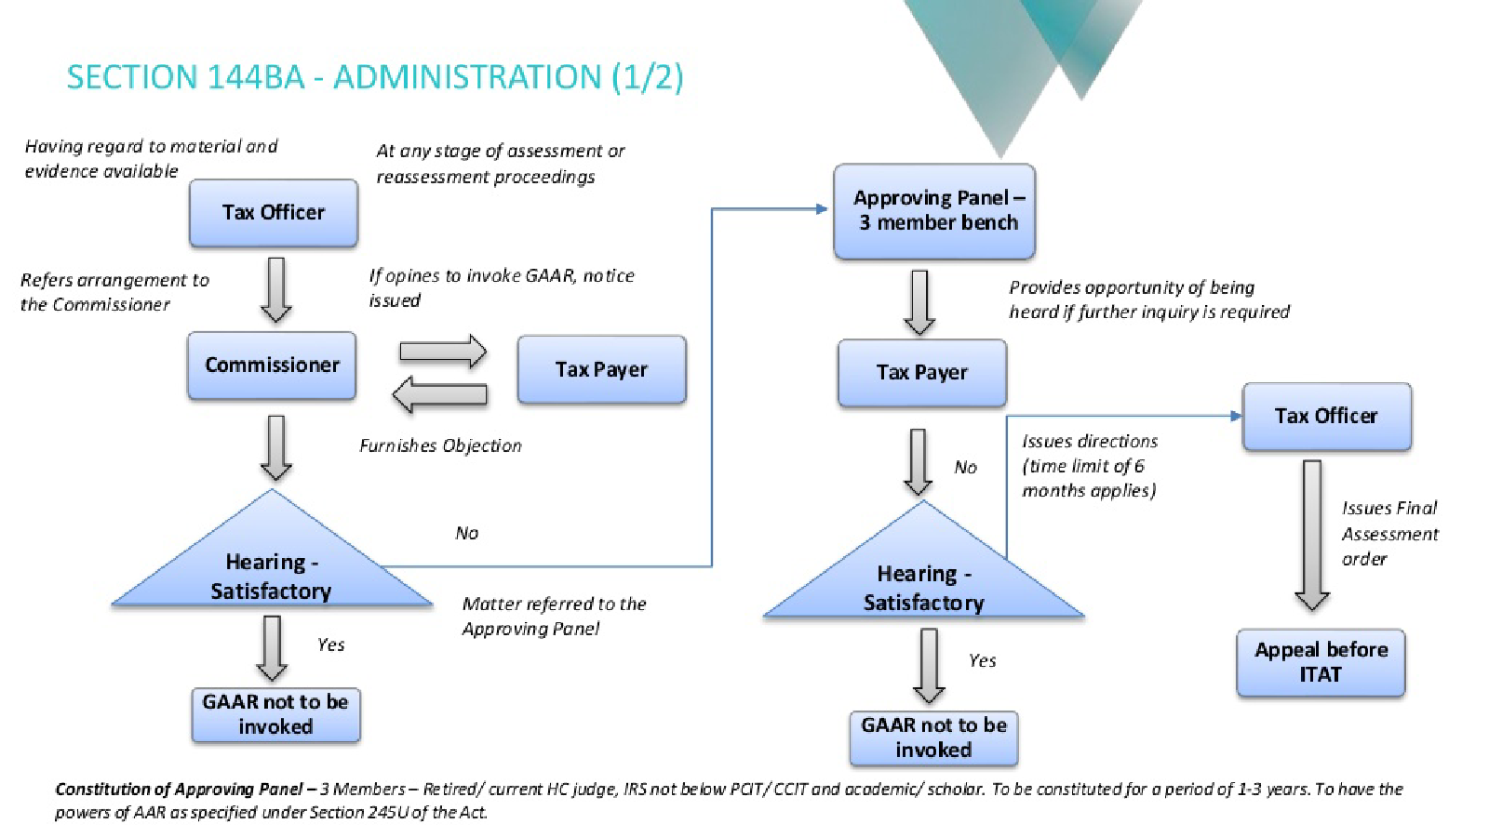

Slide 17
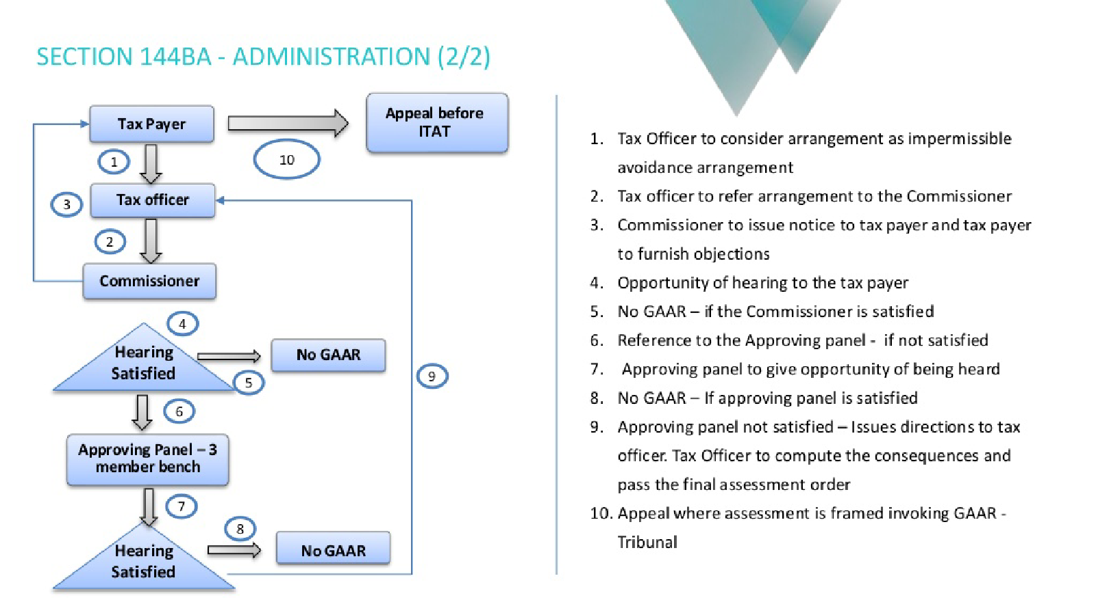

Slide 18
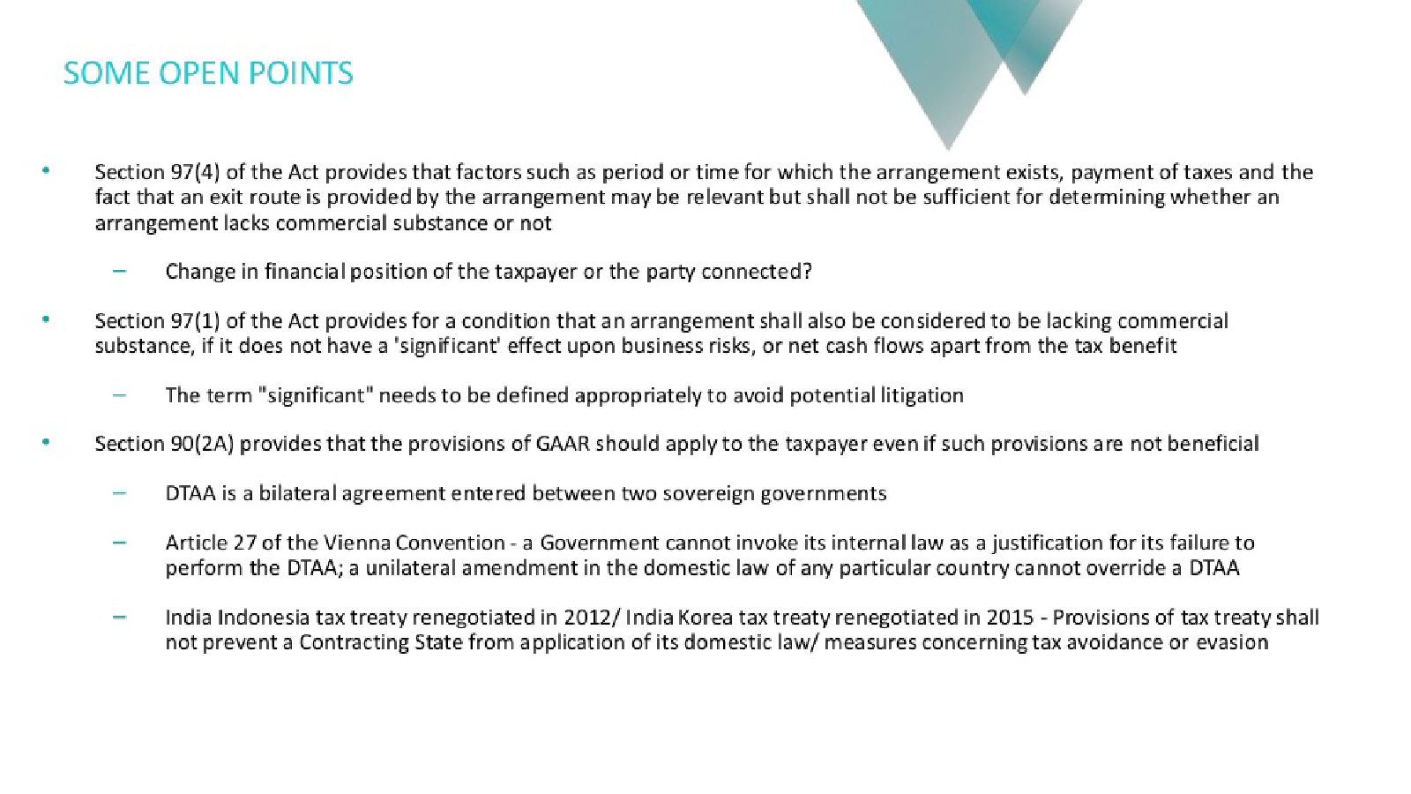

Slide 19
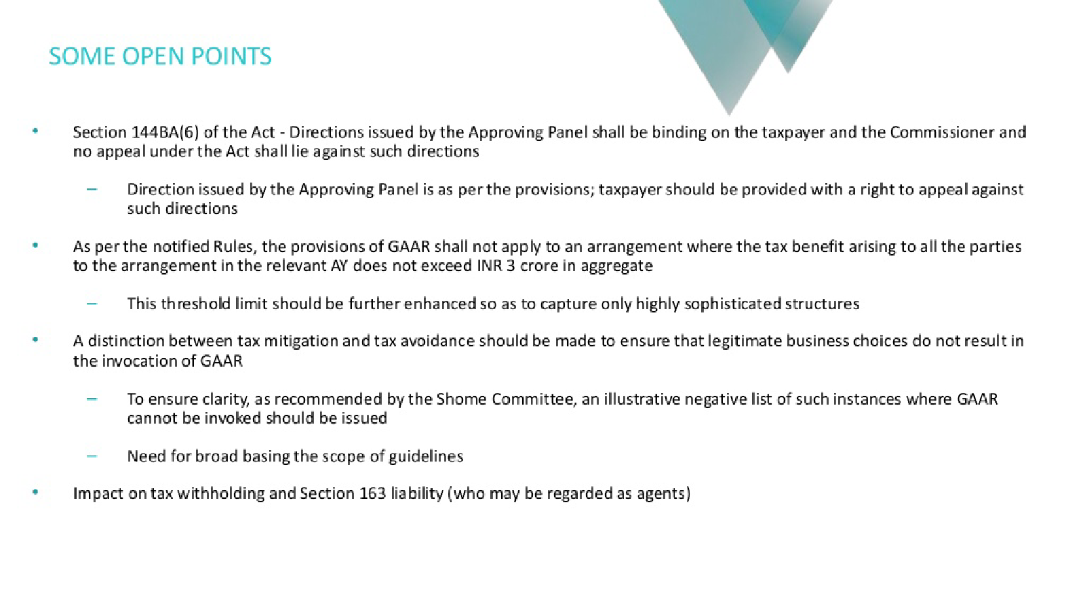

Slide 20


Slide 21
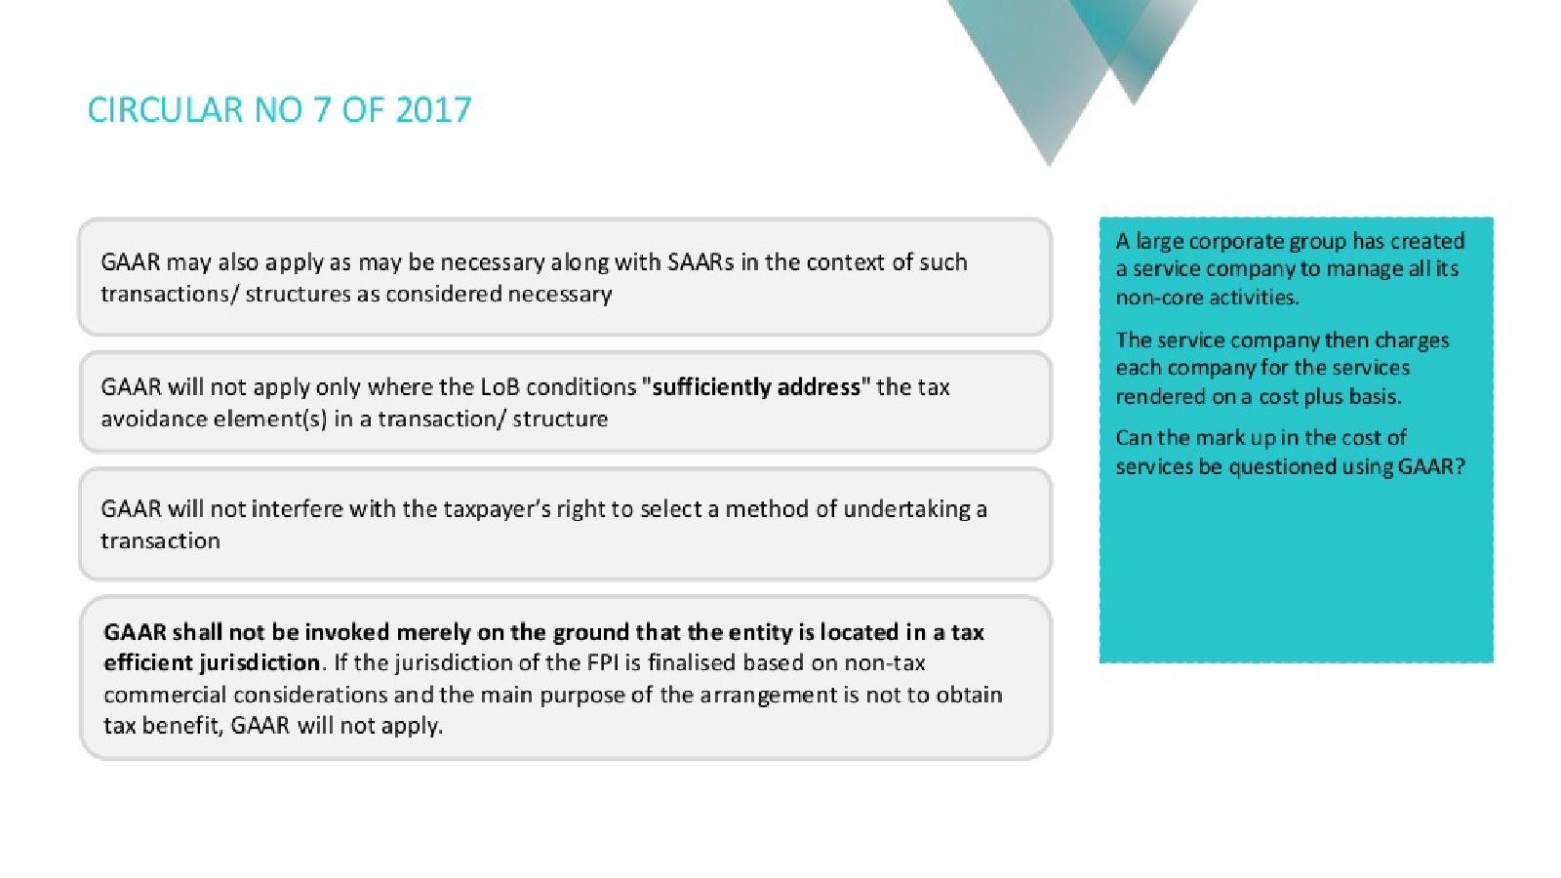

Slide 22
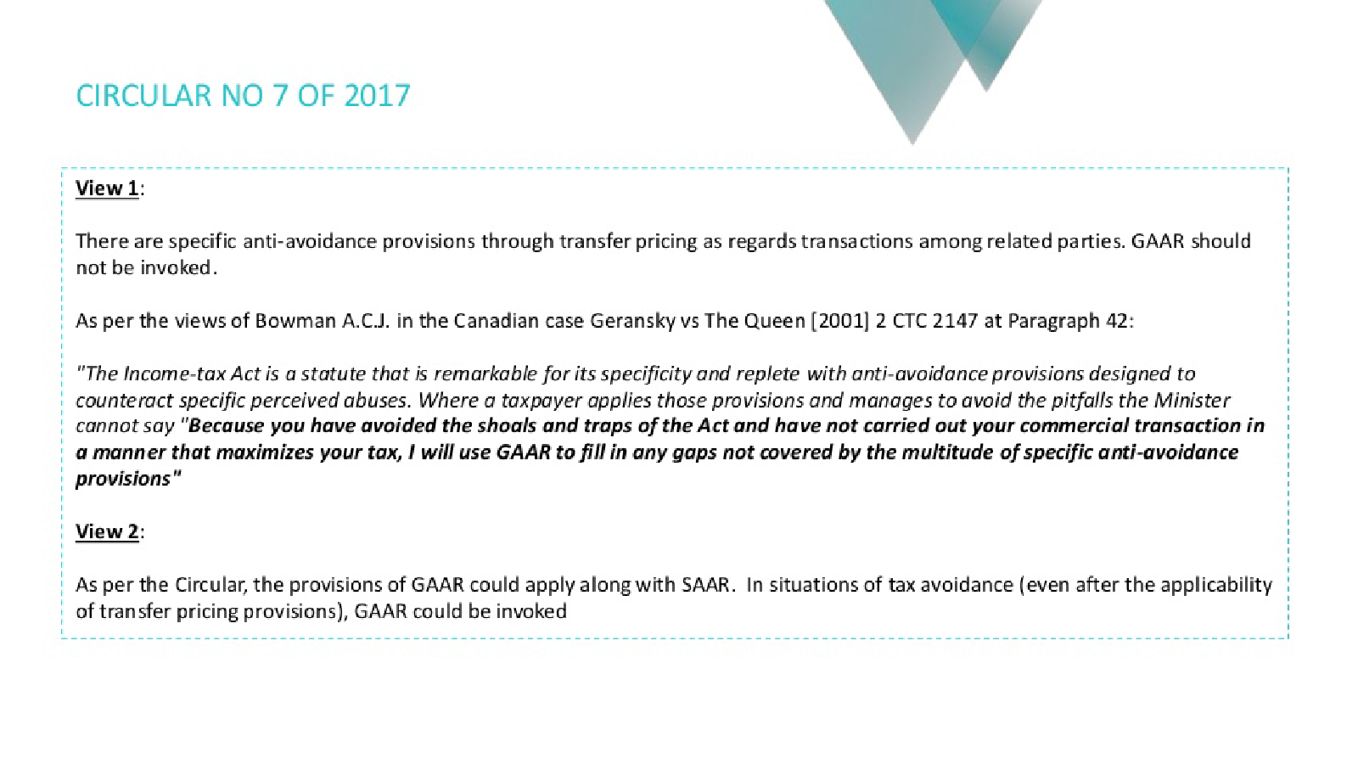

Slide 23
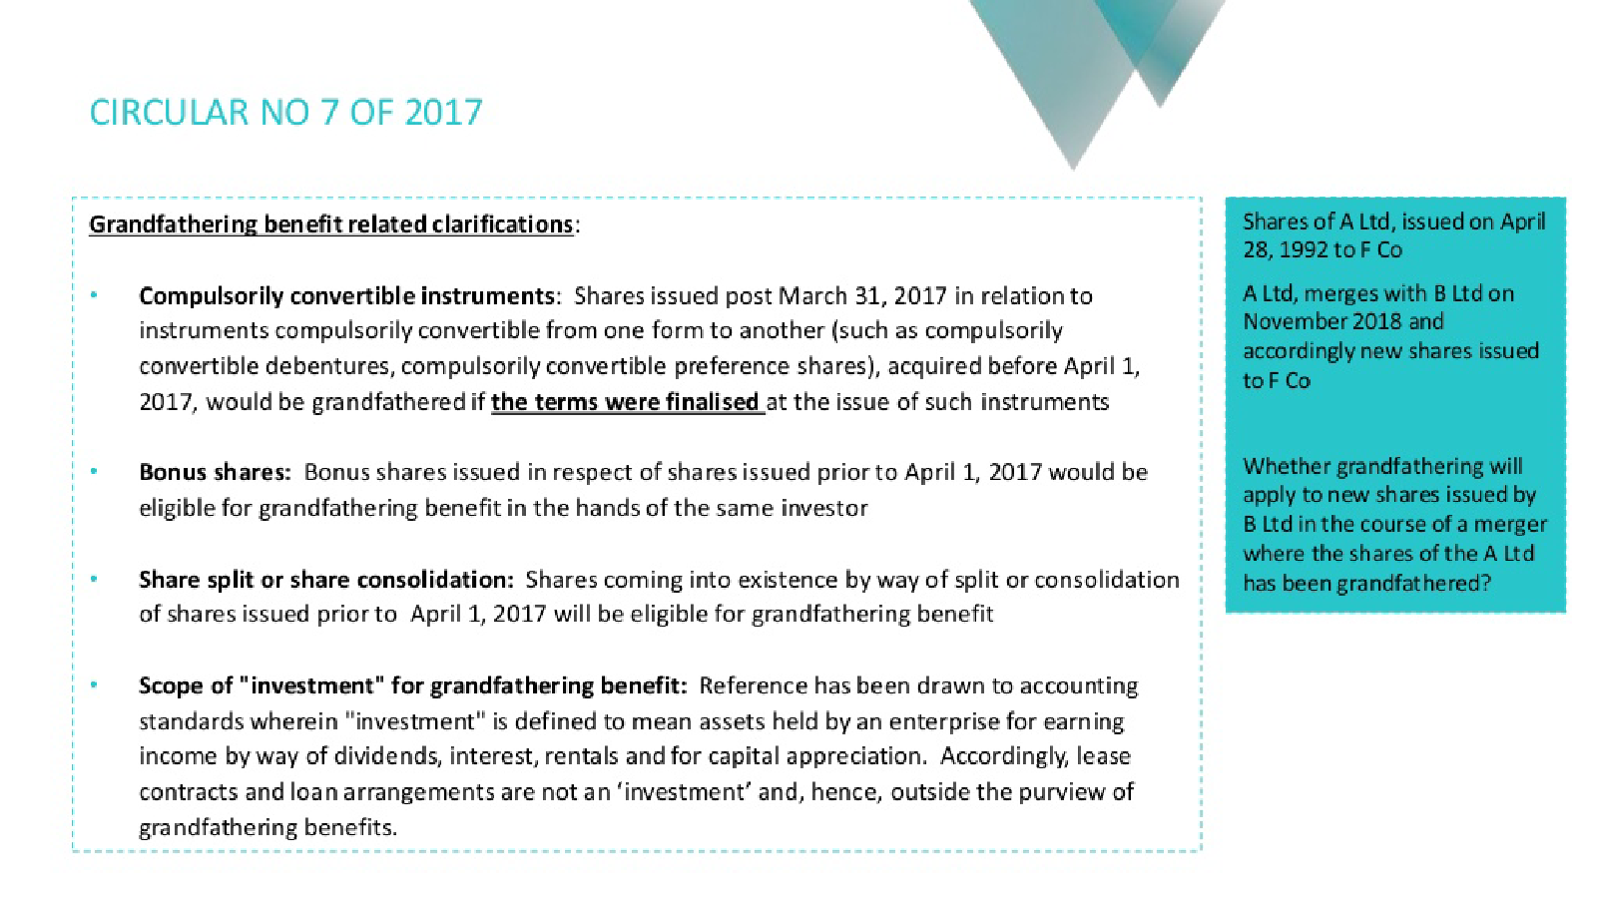

Slide 24
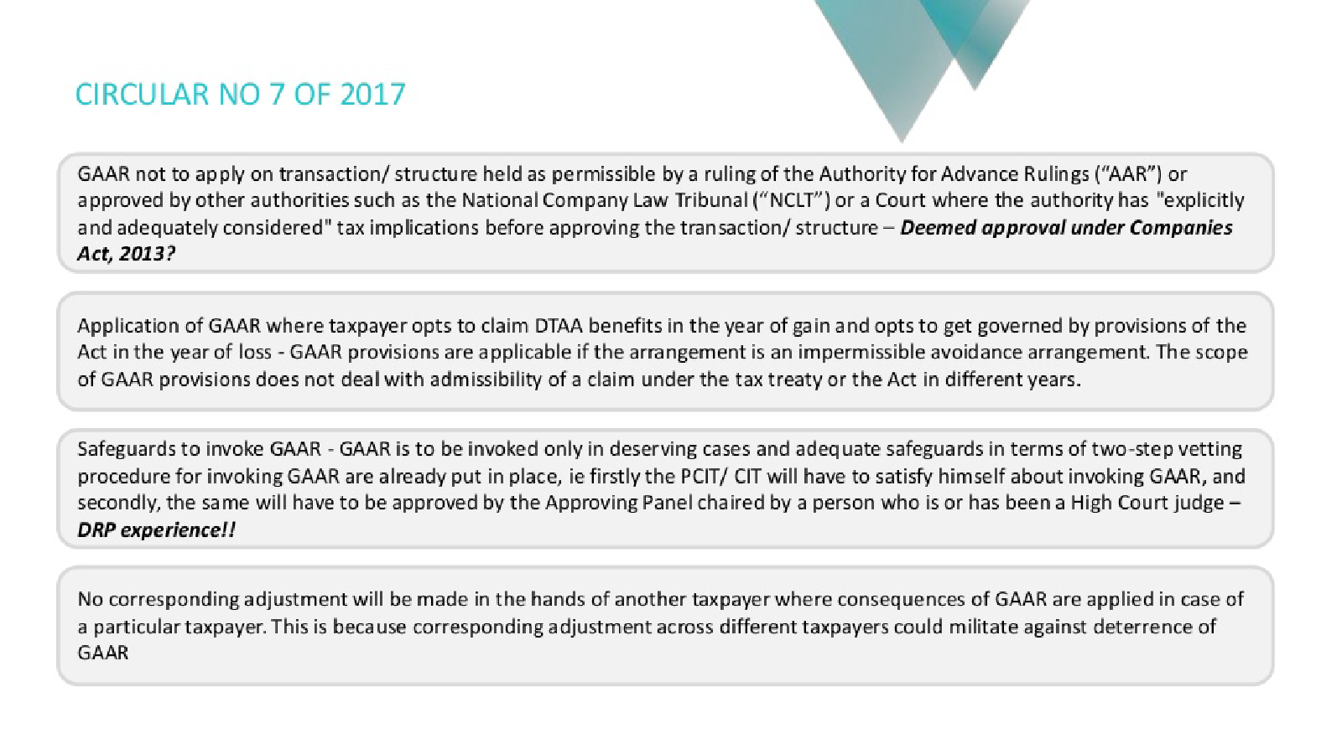

Slide 25
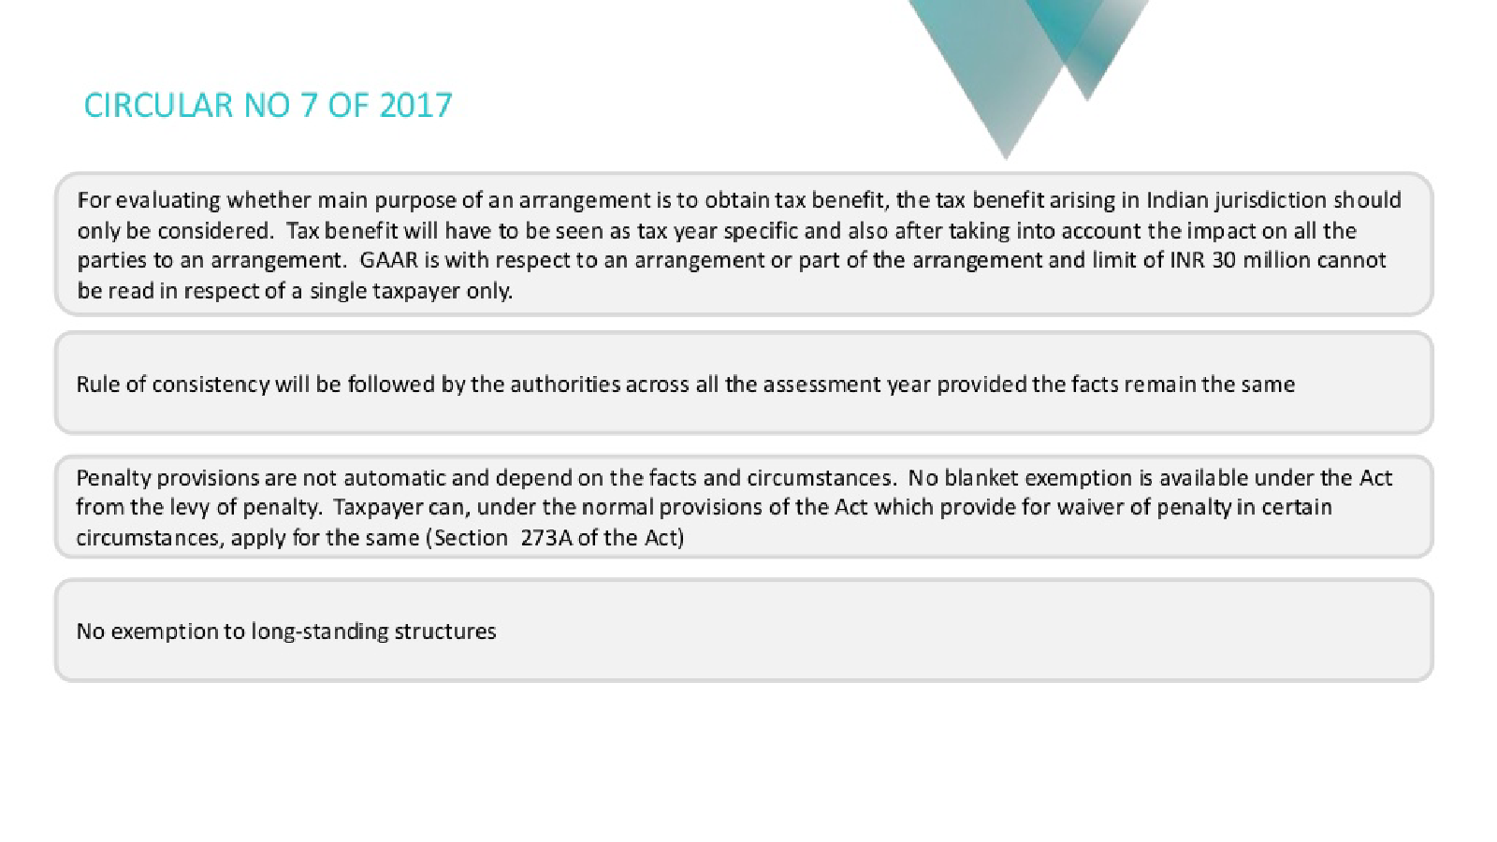

Slide 26
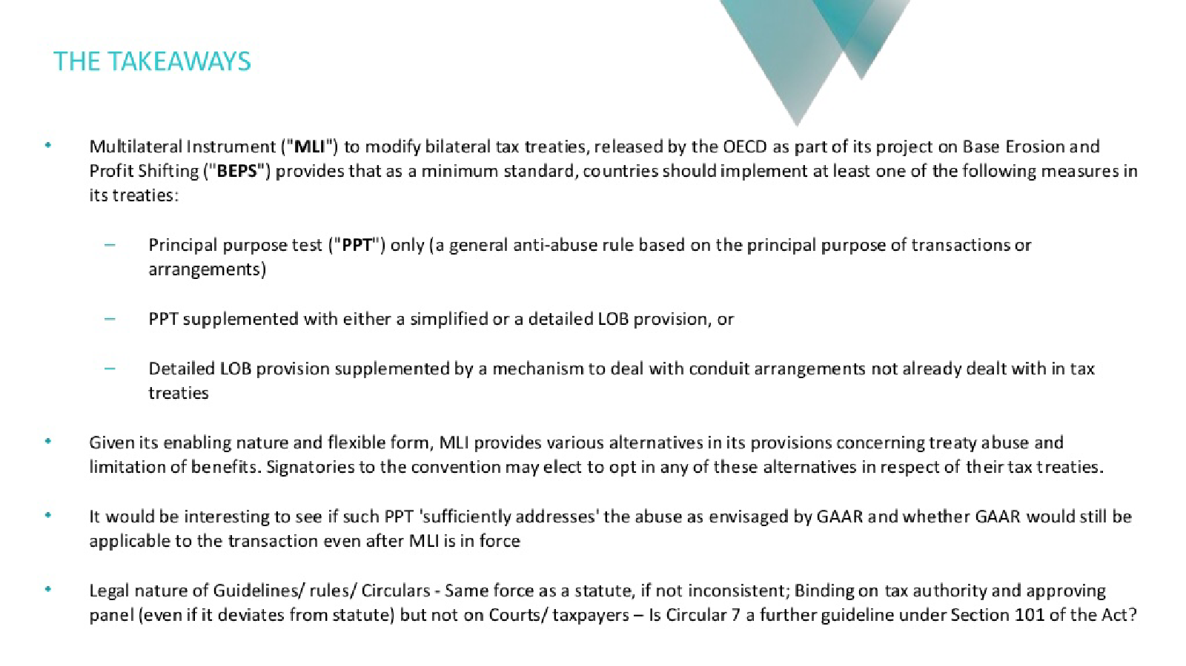

Slide 27
Some recent judicial decisions in India Shiv Raj Gupta [TS-778-HC-2014(DEL)]
The assessee was the Chairman-cum-Managing Director of a company in which he with his family members held 1,86,019 shares, constituting 57.29% of the paid-up equity share capital. The shares were by assessee and his family members @ Rs.30/- per share for a total consideration of about 56 lakhs. Assessee on the same date further entered into another MOU with purchaser in his individual capacity, which created a restrictive covenant to the effect that assessee shall not either directly or indirectly carry on any manufacturing or marketing activities relating to vendor company for a period of 10 years. For this, assessee received a non-compete fee of Rs.6.60 crores. The non-compete fee was claimed as non-taxable in subject AY 1995-96 applying SC ratio in Guffic Chem [TS-97-SC-2011]

Slide 28
Shiv Raj Gupta [TS-778-HC-2014(DEL)] ………….. continues
In this case, HC re-characterized non-compete fee received as consideration for share transfer and concluded that sale consideration for transfer of shares was artificially and deceitfully bifurcated under a sham agreement which was unreal. HC held that non-compete consideration received by assessee (director of 'vendor' company, who along with family members held 57% of capital) from buyer company on transfer of 'vendor' company's shares was taxable as capital gains. HC analysed tax avoidance vs tax evasion and tax mitigation in light of principles discussed in Vodafone, McDowell & Ramsay rulings. HC observed that "the dividing line as per the ratio in Vodafone's case (supra) is ethically principled and moralistic as tax avoidance is disapproved when the assessee adopts a colourable device, dubiousness and otherwise indulges in a sham arrangement or transaction.” HC held that real and true nature of transaction was sale of shares and transfer of control and management of vendor company in favour of the purchasing group.

Slide 29
Shiv Raj Gupta [TS-778-HC-2014(DEL)] ………….. continues
HC held that non-compete fee paid was 10 times more than sale consideration and observed that “The figure per se does not appear to be a realistic payment made on account of non-compete fee, dehors and without reference to sale of shares, loss of management and control of CDBL.” HC concluded that “It will be unintelligible, if not being gullible, if we accept that bundle of rights including non-compete right acquired on the sale of shares of a thriving and running company would be and should be accepted at Rs.56 lacs approximately but Rs.6.60 crores was not the consideration paid for the said transaction or not solely relatable to the purchase of shares. Thus, to hold the two agreements were independent, one related to sale of shares of CBDL and the other a “non-compete” agreement, would be to ignore reality, insularize ourselves and treat sham and deceit as a true and real event.”
Note : The arrangement in this case is likely to fall under clause (a) and (d) of Sec. 96(1) i.e. (d) abnormality in transaction.

Slide 30
Killick Nixon Limited [TS-148-HC-2012(BOM)]
The assessee, Killick Nixon Limited, provided a guarantee to the extent of Rs 100 crores in favour of Vysya Bank Ltd for extending financial facilities to Geekay Exim India Ltd, a company belonging to G. K. Rathi Group. Since Geekay Exim India failed to repay its loan, the bank invoked the guarantee under which the assessee agreed to transfer its own land to the Bank. In a return filed for AY 2001-02, the assessee set off capital gains arising on sale of land against the short term as well as long term capital loss arising from sale of shares.
HC held that capital loss arising on sale of shares of associated companies, 'artificial', not allowed. HC held the share transactions as "sham".
Note : The arrangement in this case is likely to fall under clause (a) and (d) of Sec. 96(1) i.e. non arm’s length terms of transaction and abnormality.

Slide 31
Aditya Birla Nuvo Ltd. , Tata Industries Ltd. , New Cingular Wirelsss Services Inc. [TS-346-HC-2011(BOM)]
Bombay HC held that capital gains on sale of shares of Idea Cellular Ltd by its Mauritian shareholder AT&T Cellular P Ltd (AT&T Mauritius) were not exempt under India Mauritius treaty as the beneficial owner and investor was New Cingular Wireless Services Inc, USA (NCWS). HC noted that shares of Idea was allotted to AT&T Mauritius as permitted transferee of NCWS under share purchase agreement and JV agreement. Further, AT&T Mauritius has not right in Idea shares, but all the rights were continued to be exercised by NCWS and shares could not be sold by AT&T Mauritius without NCWS approval. HC held that there was no document on record to suggest that AT&T Mauritius has agreed to subscribe shares of Idea.
Note : This transaction can be regarded as impermissible arrangement as it can be held to be lacking substance in terms of Sec. 97(1)(c). Further, it will fall foul of proposed modified preamble as per which treaty cannot create opportunities for non-taxation or tax avoidance or evasion.

Slide 32
Abhinandan Investment Ltd [TS-666-HC-2015(DEL)]
The taxpayer renounced rights in partly convertible debentures PCDs in favour of another group company (‘JSL’) at a significantly lower price than market value resulting in significant loss. The Court took note of peculiar facts whereby assessee sold JSL shares during relevant year resulting in substantial capital gains, and at the same time undertook transaction of renunciation of rights resulting in huge losses. HC opined that “In order to avoid paying the tax, the investment companies including the Assessee entered into transactions for renunciation of rights with related companies of the same group. These incestuous transactions were for no other business purpose but to contrive a loss in the hands of assessee who had incurred a tax liability on account of the gains made”. , HC concluded that “This would be an abuse of the corporate form and such transactions, even though implemented, cannot be considered to be other than a colourable device for avoidance of tax.
Note: The transaction lacks commercial substance thus, can be considered as impermissible arrangement.

Slide 33
Multilateral Convention (MLI) and BEPS…...backdrop
Increasing global awareness about the MNCs not paying fair share of taxes, and resultant impact on political agenda
Dissatisfaction with international tax rules, and gap between domestic law and tax treaties, permitting artificial segregation of taxation with the related economic activity
Global businesses perceived to be behaving in an unethical manner, even if compliant with the law

Slide 34


BEPS PROJECT – How it proceeded
Addres
Action Plan endorsed by
G20
G20
endorses BEPS Package
TREATY ___Dividend___ _____ PE- ____
September 2013
November 2015
Implementation phase
Addres
BEPS background report
Launch of BEPS
Package

Slide 35
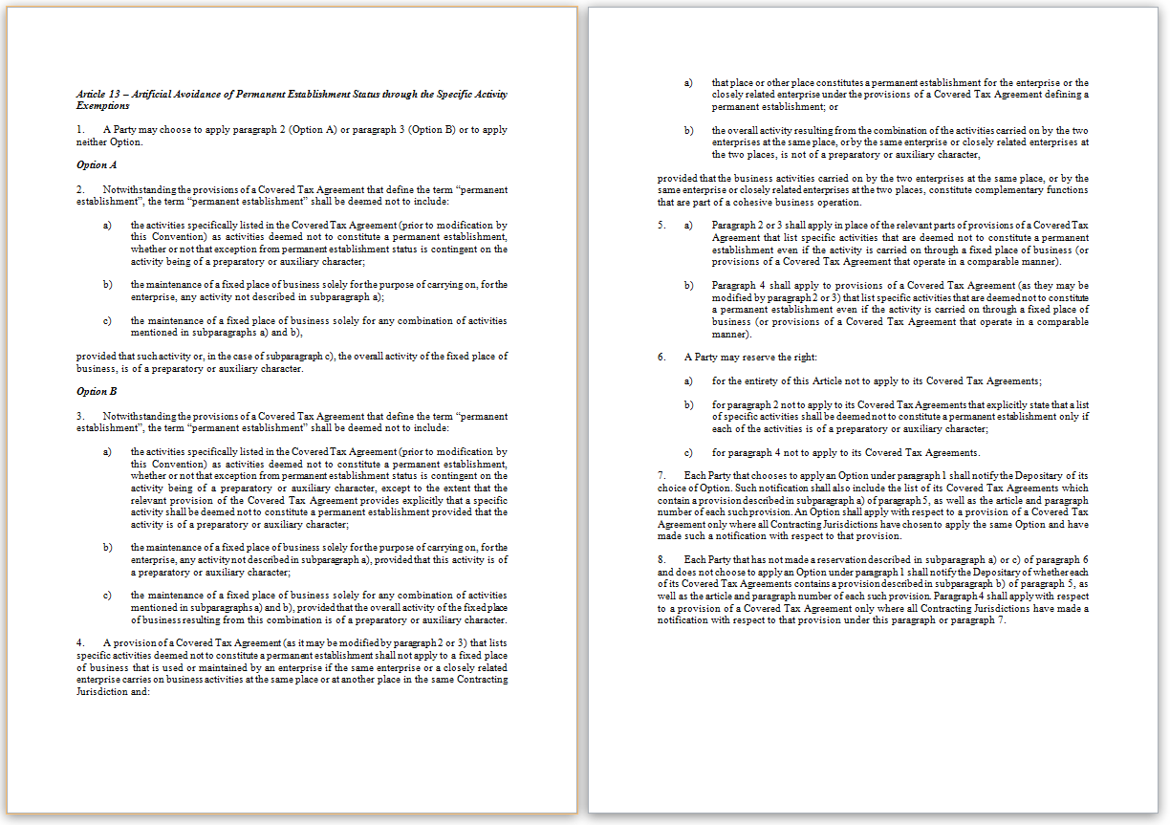


HOW TO MODIFY 3000+ TAX TREATIES
TREATY ___Dividend___ _____ PE- ____
TREATY ___Dividend___ _____ PE- ____
TREATY ___Dividend___ _____ PE- ____
TREATY ___Dividend___ _____ PE- ____
Bilateral renegotiations
Multilateral negotiations
TREATY ___Dividend___ _____ PE- ____
MULTI LATERAL TREATY
Multilateral treaty
to sit on top of and modify bilateral tax treaties

Slide 36
MULTILATERAL NEGOTIATIONS
Substance of tax treaty-related BEPS measures agreed in the BEPS Package
Focus: How to modify tax treaties to implement the agreed BEPS measures
Development of provisions on mandatory binding MAP arbitration
Notes:
This is to give an overview of the provisions. Part I and Part VII are general and procedural.
When making policy decisions, the focus will be on Part II-VI that implement the treaty related BEPS measures.
Announce that we will focus on the BEPS minimum standards:
Those developed under Action 6 are included in Part III
Those developed under Action 14 are included in Part V
Next, we will have a look at the implementation of the minimum standards/

Slide 37
BEPS Action Reports addressed by MLI
Action 2
Hybrid Mismatches
Action 6
Prevention of Treaty Abuse
AGREED MINIMUM STANDARD
Action 7
Avoidance of Permanent Establishment Status
Action 14
Improving Dispute Resolution
AGREED MINIMUM STANDARD

Slide 38
MULTILATERAL CONVENTION TO IMPLEMENT TAX TREATY RELATED MEASURES TO PREVENT BASE EROSION AND PROFIT SHIFTING
Developed by more than 100 countries and jurisdictions: Ad-hoc Group of Experts
Modification of thousands of existing tax treaties
Accommodation of different tax treaty policies
English and French text authentic
(Countries are preparing additional language versions)

Slide 39
Mechanics – Elements of flexibility
Specifying tax treaties covered
Flexibility with respect to minimum standard provisions
Opting out of non-minimum standard provisions
Opting out of provisions for treaties that contain certain existing provisions with specific characteristics
Choices to apply optional and alternative provisions (including opting in to Part VI on Arbitration)

Slide 40
STRUCTURE OF SUBSTANTIVE
PROVISIONS (ART. 3 THROUGH 17)
Agreed BEPS measure that forms the basis of the provision of the Convention
Compatibility clause(s) which define the relationship between the provisions of the Convention and Covered Tax Agreements in objective terms
Reservation clause(s) that define the reservation(s) permitted with respect to each provision

Slide 41
STRUCTURE OF SUBSTANTIVE
PROVISIONS (ART. 3 THROUGH 17)
Notification clause(s) reflecting choices of optional provisions
Notification clause(s) to ensure clarity about existing provisions that are within the scope of compatibility clauses.

Slide 42
Mechanics – Compatibility clauses
“in place of”
“applies to”
or
“modifies”
MULTILATERAL CONVENTION TO IMPLEMENT TAX TREATY RELATED MEASURES TO PREVENT BASE EROSION AND PROFIT SHIFTING
EXISTING TAX
AGREEMENT
EXISTING TAX
AGREEMENT
EXISTING TAX
AGREEMENT
EXISTING TAX
AGREEMENT
EXISTING TAX
AGREEMENT
“in the absence of”
“in place of or in the absence of”

Slide 43
MLI….............. the basics
MLI is a multilateral treaty which modifies more than 3,000 bilateral treaties
One collective negotiation
Only one signature and one ratification
MLI modifies rather than amend the treaties by amending protocol
Applied alongside existing bilateral treaties
Jurisdictions have consented to modify their rights and obligations under the bilateral treaties
Consent at the later in time prevails
Bilateral treaties can be subsequently modified
Evolution of mutual consent

Slide 44
MLI….............. the basics
Covered Tax Agreements
India has notified all its DTAAs as CTA
Some of India’s treaty partners have not signed the MLI
These agreements would not be modified
Some of India’s treaty partners have not included India as CTAs
These agreements would not be modified
Mauritius, Germany
During Peer Review may be examined the reasons – treaty recently negotiated or under renegotiation to include BEPS outcome

Slide 45
MLI….............. the basics
Reservations
In many cases, India has put reservations on application of certain provisions of MLI which are not minimum standards – those provisions would not be applicable. Taxation of transparent entities.. Even though this is being handled on case by case basis such as in Indo UK tax treaty
In many cases, India’s treaty partners have put reservations on application of certain provisions of MLI which are not minimum standards – those provisions would not be applicable

Slide 46
MLI ………….… impact on preamble
Article 6 – Purpose of a Covered Tax Agreement (Minimum Standard)
Article 6(1) – A CTA may be modified to include the following preamble text (Compulsory)
“Intending to eliminate double taxation with respect to the taxes covered by this agreement without creating opportunities for non-taxation or reduced taxation through tax evasion or avoidance (including through treaty-shopping arrangements aimed at obtaining reliefs provided in this agreement for the indirect benefit of residents of third jurisdictions),”.

Slide 47
Importance of preamble
The preamble language of Article 6(1) is compulsory and will be added to every CTA by operation of the phrase “in place of in the absence of”
Article 6(4)
Where all Contracting Jurisdictions gave notification of preamble language in their CTA – the preamble language is replaced by text in Article 6(1)
In other cases i.e. in case of only one jurisdiction giving notification or neither of the jurisdictions giving notification, the text of Article 6(1) is added to the text in the preamble of the CTA
Article 31(2) of the Vienna Convention
Context of treaty interpretation includes Preamble

Slide 48
Principal purpose test
“Notwithstanding any provisions of a Covered Tax Agreement, a benefit under the Covered Tax Agreement shall not be granted in respect of an item of income or capital if it is reasonable to conclude, having regard to all relevant facts and circumstances, that obtaining that benefit was one of the principal purposes of any arrangement or transaction that resulted directly or indirectly in that benefit, unless it is established that granting that benefit in these circumstances would be in accordance with the object and purpose of the relevant provisions of the Covered Tax Agreement.”
Wider than GAAR – one of the principal purposes
No grandfathering provision
Application of “in place of or in the absence of” – compulsorily applicable

Slide 49
Interpretation of a treaty now
Look at the tax treaty
Is it a CTA
If yes, see the provisions of the MLI
Consider the stand of the countries involved
Does domestic law come to rescue of the taxpayer (Indian GAAR example- principal purpose test vs one of the principal purpose)
Role of reservations expressed by a jurisdiction, for the purpose of judicial interpretation - a contentious issue- alternative points of view

Slide 50
Can BEPS be a judicial policy consideration ?
Baker Hughes Singapore Pte Ltd [TS-214-ITAT-2015(DEL)]
ITAT, while ruling on Sec 44BB applicability, dealt with Revenue's submission that assessee's stand would amount to base erosion and profit shifting from developing countries. ITAT held that base erosion and profit shifting (BEPS) is a tax policy consideration which is relevant for law making process. Remarking that BEPS considerations cannot have a role in judicial decision making process, ITAT observes that "judicial process will infringe neutrality if it is to be swayed by such policy consideration". Judicial authorities are to interpret the law as it exists and not as it ought to be in the light of certain underlying value notions.

Slide 51
Any questions!
Pramod.itat@gmail.com
Presentation is in personal capacity. It does not reflect the views of India’s Income Tax Appellate Tribunal and the Government of India . My thanks to Rahul Navin IRS, New Delhi, and Sumit Jhunjhunwala FCA, Bangalore, for use of some of their slides.

